Slide 1
IA Summit 2009
“summer camp for IAs”
Keynote (Dr. Michael Wesch)
Amazon Redesign (Jared Spool)
Other interesting bits
Notes:
Attendance down – approx 500 people vs. last years 700 people
Great location – Peabody Memphis, watch the ducks, walk to Beale St., bar in lobby was unofficial hangout place after days sessions over
Theme lunches – sit at a table with people who share your common interests. Agile table one day

Slide 2
“Mediated Culture” Michael Wesch
how information is architected becomes how human relations/culture is architected
Namba Tok - ethnographic researcher in Papua New Guinea.
govt got serious about running the villages. census and other numbers determined funding.
name/identity - previously determined by relationships between people, now name is “census name”
census demanded one name, Namba Tok (numbers that talk to the state)
impact huge - led to reorganizing of housing in the village (grid oriented vs people oriented)
“media are not just tools of communication. when media changes, relationships change”
Notes:
Media shape our relationships. Media mediates relationships between people. When media changes, relationships change.
Increasingly individualized and longing for connection.
Medias roles in creating distance and connecting us

Slide 3
“Mediated Culture” Michael Wesch
The Machine is Us/ing Us
User-generated mediascape
User-generated content (YouTube), filter (Digg), organization (Del.icio.us), distribution (RSS feeds), tags (del.icio.us), blogs (commentary), ranking (Technorati) – not just a technological revolution, but a cultural revolution
“How do different media shape the way we interact today”
YouTube – connection without constraint
Twitter - mindcasting
4chan
“People have a way to talk back and they are using it.”
“architectures of participation become architectures of real life”
IA = Building architectures for a future of whatever
Collapse of context – things we do and say have a life outside their context
No slides available yet, but similar presentation at http://www.youtube.com/watch?v=TPAO-lZ4_hU
Notes:
Machine is Us/ing Us
#1 video in blogosphere vs. $2,600,012.79 Doritos ad
Collaborated with musician in the Ivory coast.
253 views on Friday, Saturday (digg – user generated filtering)
“interesting thing not the video, but the aftereffects”
Problem of Insignificance & Generation Me
Insignificance
MTV generation: short attention span, materialistic, narcissistic
“whatever” (a brief history of how it is used over time)
pre 1960s “whatever. that’s what I meant”
late 60s “I don’t care. Whatever” indifference
1990s MTV generation - the indifferent meh/eh and whatever. simpsons episode
late 90s - now. “Whatever. I’ll do what I want.” I’m what matters. American Idol frenzy. self-righteousness, narcissism
Generation Me - they think they deserve to be on stage, but are shocked when they are not.
New Media create new forms of
Expression
Empowerment
Identity
Community
YouTube:
Lots of people upload stuff from their family, but up to 15% videos are remakes of popular videos (Charlie bit me). More than 10K videos are made for the YouTube community.
lots of people have deep, profound YouTube community (what does it mean you? Free Hugs – over 30mil views, replicated around the world)
- What does it mean to create a community through a webcam? Everything is screened. You present the image you want
Cultural tension between individualism and independence. YouTube offers the possibility to connect without constraints.
One Hand (You are not alone, we are connected, love on another, we are all connected) – they feel these cultural values are not as prevalent as they’d like to see so that’s why they feel the need to say it.
Twitter
Lifecasting, “ambient intimacy” Leisa
See yourself more clearly, see self as how your present yourself.
4chan
Everyone can be anonymous
“primordial ooze from which internet creativity comes from”

Slide 4
Amazon Site Redesign: Jared Spool
“Why can’t we just do it like Amazon?”
Attention to detail
Search results show when are you going to get it?
Add to shopping cart
Engaging through content
Reviews – sort by most helpful, show top and bottom reviews
Don’t fear new ideas
Some work well (“people who bought this also bought…”), others do not (“tagging”)
$1 added to order = $750 mil in revenue
Notes:
70 billion visitors/month
$19 billion dollars in revenue in 2008.
Amazon doesn’t redesign – they evolve and tweak their ideas.
Attention to detail – Amazon’s competitor is you getting in your car and going to the store. See ship date on gallery and details page.
Shopping cart button moves around in subtle, not very noticeable ways.
Reviews – 3,000 Harry Potter reviews. More reviews != more value. Included “Was this helpful to you?” Customers scan negative reviews to see if there is something that they missed in their research. Now sort by most helpful positive and negative reviews.
Other sites (Target, Walmart, Barnes & Noble) have much lower sets of reviewers. Reviewers are “Amazon’s lunatic fringe”
Don’t fear new ideas –
Cat 5 cable – lots of tags, “pure garbage, astronomically dumb, as effective as dog hair, iq test, snake oil, rip off, waste of money”
Over 1100 items tagged “waste of money”

Slide 5
Amazon Site Redesign: Jared Spool
Reduce tool time while delivering confidence
Goal time vs tool time, purchase without logging in (reduction in tool time)
Phased rollout of changes – in 12 weeks
5000 noncookied users/day
1 in 5 non-cookied users
5000 new cookied users/day
1 in 5 cookied users
everyone
Never forget the business
Amazon sells below cost. Turnover of inventory in 20 days but payment terms 45 days. Sitting on money from day 23 to 44. $19 bil/year.
Notes:
Reduce tool time while delivering confidence
Goal time - time spent to improve outcome of experience
Tool time - time spent that does not impact quality of outcome
Purchase without logging in. Security levels
0 – A doesn’t know who you are. (no cookie) can browse, compare
1 – Amazon knows you from a cookie. Buy via one-clock.
2 – Amazon knows you from a cookie, but needs to authenticate you further – asks you questions only you know about. Credit card #, password.
The Magic Behind Amazon’s 2.7 Billion Dollar Question
The $300 Million Button

Slide 6
Other interesting things
Effectively Communicating Web Analytics poster
Adam Cox, Mark Kassteen, Chris Pierson, Jacco Nieuwland
http://www.userintelligence.com/nl/ideas/publications/effectively-communicating-web-analytics
Chalkmark, Treejack, Optimal Sort
www.optimalworkshop.com
Products are in beta (free for now)
Optimal Sort – use for card sorting
Treejack – use for evaluating labels and category structures
Chalkmark - use for quick user testing

Slide 7
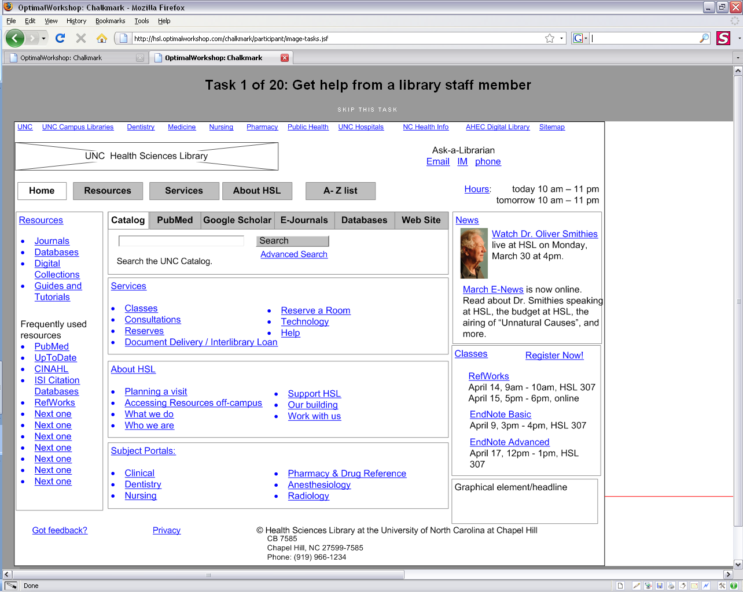
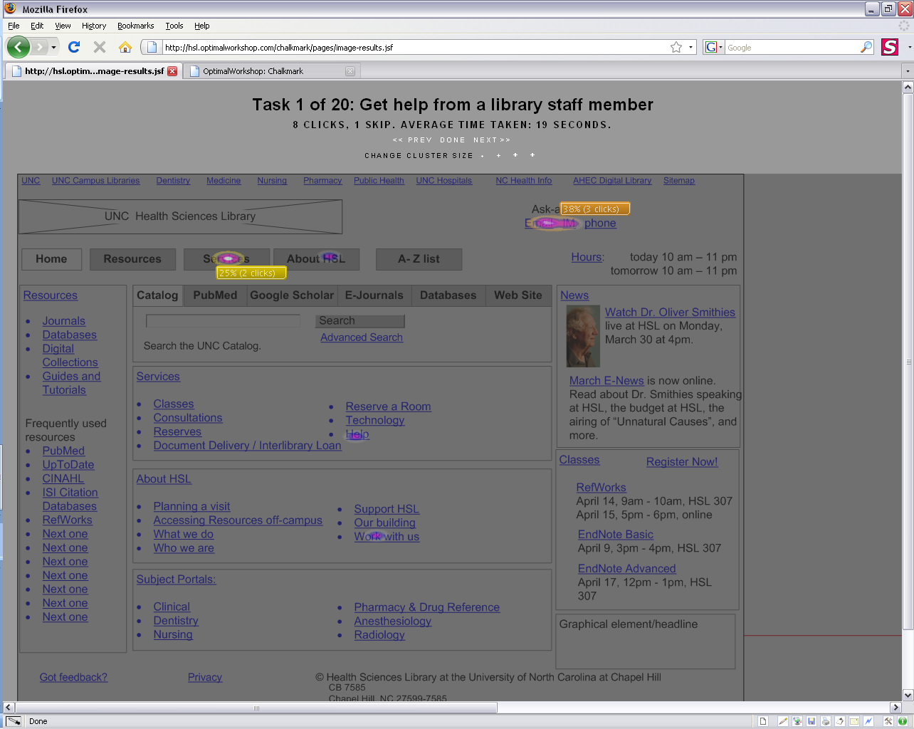
Chalkmark

