Slide 1
Effective Data Visualization Design for Dashboards
Lisa Whitman
TriUPA
May 25, 2011

Slide 2
Dashboards

Slide 3
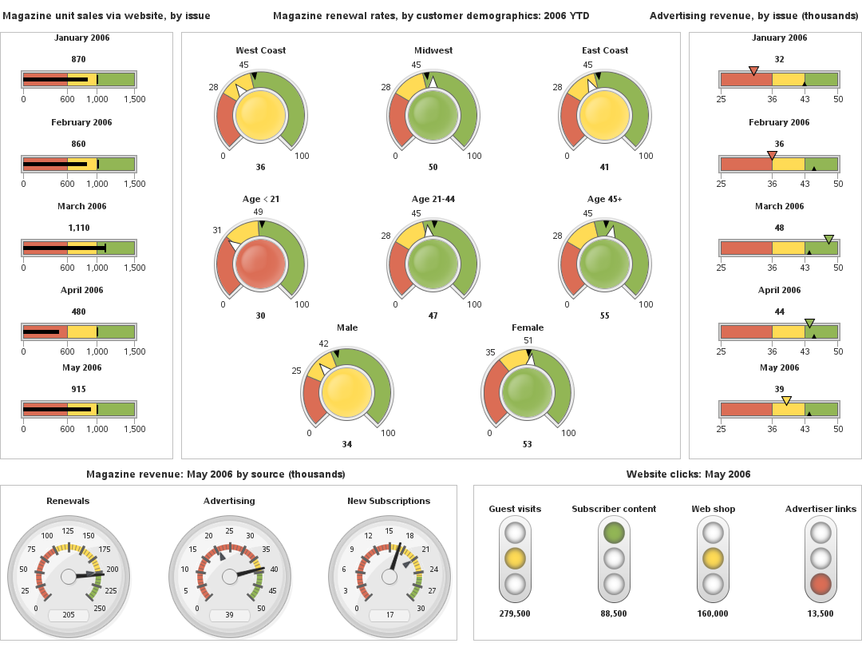
Dashboards

Slide 4
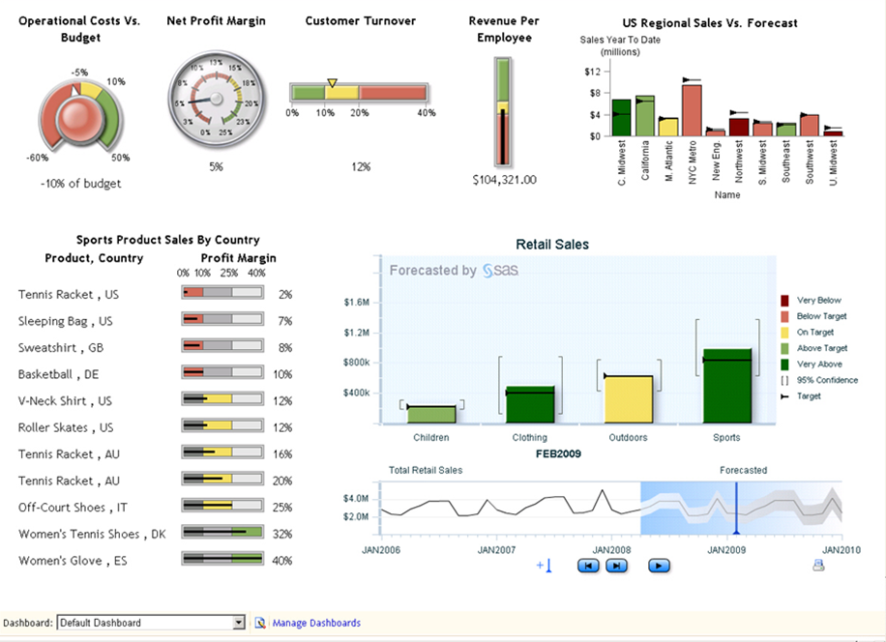
Dashboards

Slide 5
How psychology affects data interpretation
Principles of psychology can be used to help you determine the best ways to present data
Understanding the audience’s expectations
Understanding the audience’s tasks and goals
Visual perception
Attention
Memory
Usability testing to reduce error

Slide 6
Data Drives Design
Understand the story behind your data
What story is the data telling?
What is the message that you want the data to tell?
Who is the audience, and what are their goals?
What actions will the user be able to take?
Drill-down for details
Hyperlinks to additional or relevant information
Interactivity
Quick-decision making
Communication
How will the data be presented?
Computer-based display that allows for multiple pages? Interactions and linking? Animation?

Slide 7
Understand your audience
Communicate with your audience.
Help them understand what you are capable of providing so they
understand how data can help them make decisions, and
know about different ways it can be presented
See things from their point of view.
What do they need to know
On a daily basis?
On a monthly basis?
Where do they go to view data?
How do they want to view the data?
With graphics? Detailed tables of numbers?
What actions will they take? Comparisons? Drill-down?

Slide 8
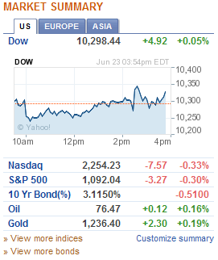
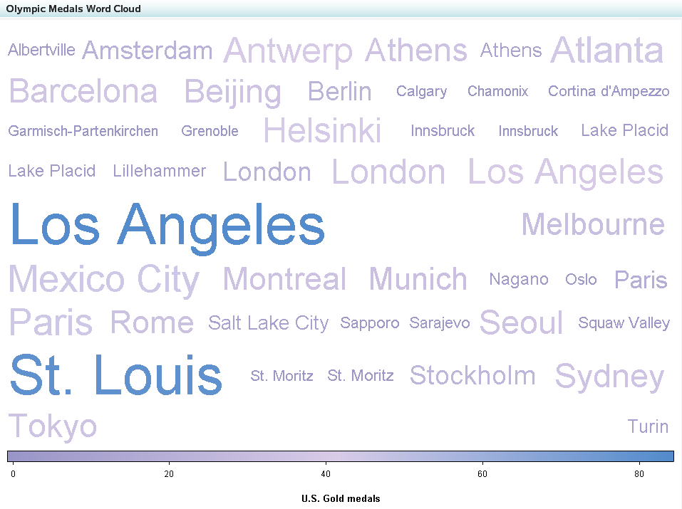
Understand your audience
Find out what they’re familiar with and what their preferences are.
Your audience may be used to visualizations that they see commonly used on shopping, stock, or news websites.

Slide 9
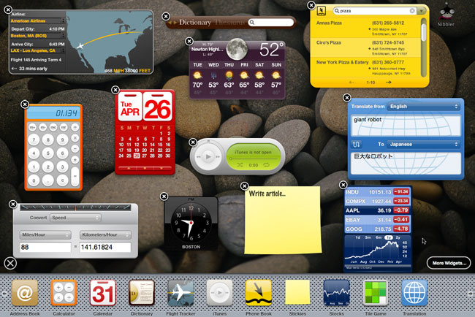
Data Drives Design
Your audience may be used to visualizations that they see every day on their desktop user interface.

Slide 10
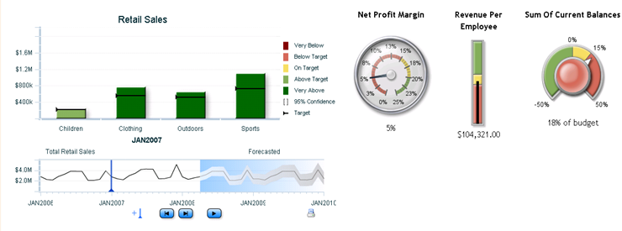
Choosing the right data visualizations
Choose data visualizations that
Convey the message clearly
Are easy to interpret
Allow the user to make comparisons
Avoid needless use of space
Help the user take appropriate action
Your audience likes and can read

Slide 11
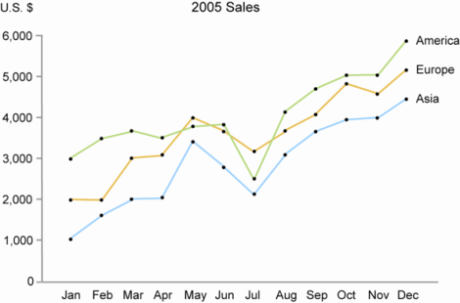
Convey the message clearly
Choose visualizations that clearly show the message of the data
If there are patterns, use visualizations that help the user spot the patterns
Line graph
Scatter plot
If there are comparisons, use visualizations that combine measures for quick comparison, like line graphs or bar charts.
If the message of the data is that something is wrong, use a key performance indicator, like a gauge.

Slide 12
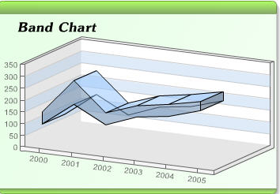
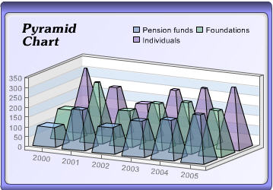
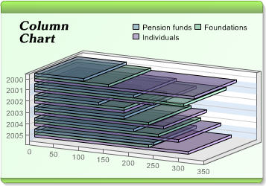
Easy to interpret
Choose data visualizations that are easy to interpret
Provide easy-to-read labeling of values.
Provide legends to explain symbols and color coding.
Avoid 3D and tilting effects that make it hard to read the graph.
Choose visualizations that are familiar to your audience.
Unfamiliar and complicated graphs take longer to interpret.
Communicate with your audience - What visualizations do they come across frequently, in reports, websites, etc.? Do they have examples in mind? Which graphics do they like?

Slide 13
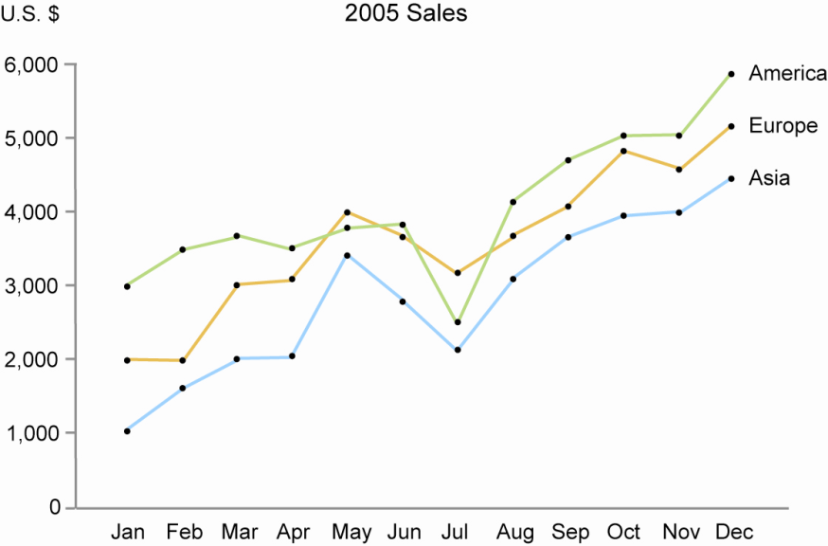
Allow the user to make comparisons
If two measures are being compared, put them in the same graph in a line chart or bar chart.
It is hard to compare measures in a pie chart or in 3D charts.
If two graphs are being compared, group them in a way that helps the user’s eye view them for comparison
Grouping
Put them in close-proximity
to each other, and leave
space around them
Enclose them in a border
Make them the same size
and orientation
Use the same graphics and labeling

Slide 14
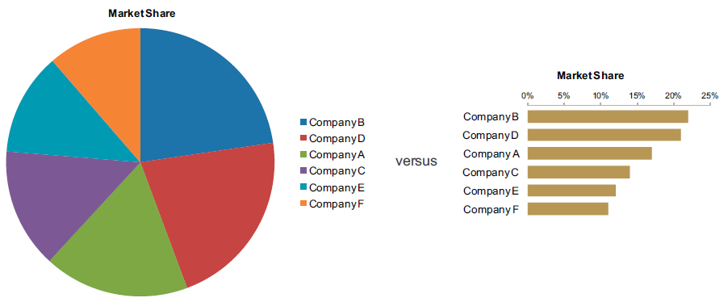
Make the most of your real estate
You want to use visualizations that avoid needless use of space
Avoid visual clutter, which distracts your user from the important information. Nothing irrelevant should be on your screen.
Be careful with large graphics that don’t convey much information. Only important data should use a lot of space.
Speedometers
Pie Charts

