Slide 1
Effective Data Visualization: What Users Want
Sidharth (Sid) Thakur,
Senior Research Data Software Developer,
Email: sthakur@renci.org
RENCI
TriUPA Panel, May 25 2011

Slide 2
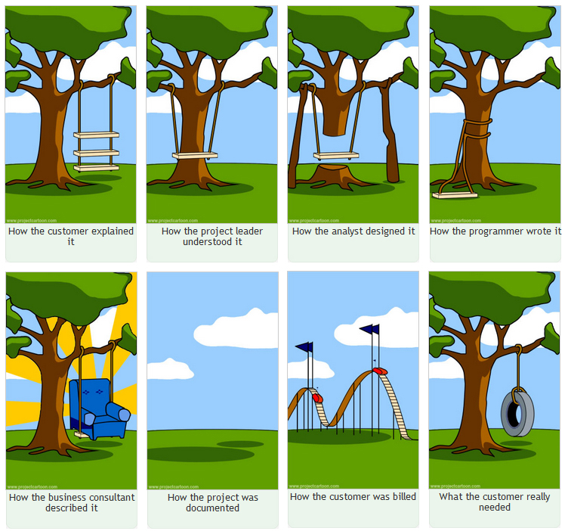
What User Needs
Source: The Project Cartoon (www.projectcartoon.com)
Notes:
As the graphic suggests, an important problem while designing user application software is miss-interpretation of user requirements and superimposition of bias of the programmer/designer. Key to overcoming this challenge is to delve deep into the user’s or client’s domain and perform in-depth analysis of visual/perceptual tasks and goals of the desired visualization application.

Slide 3
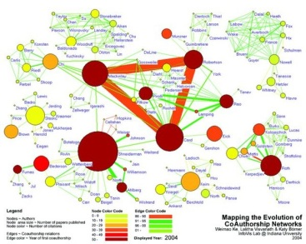
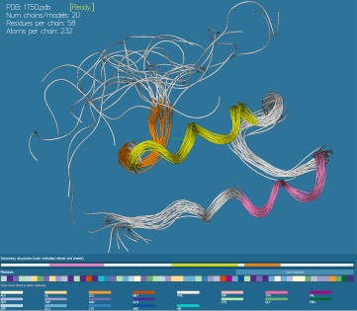
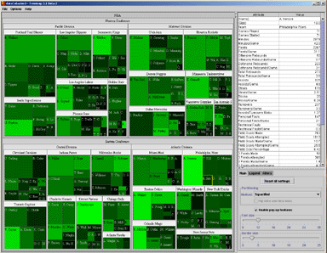
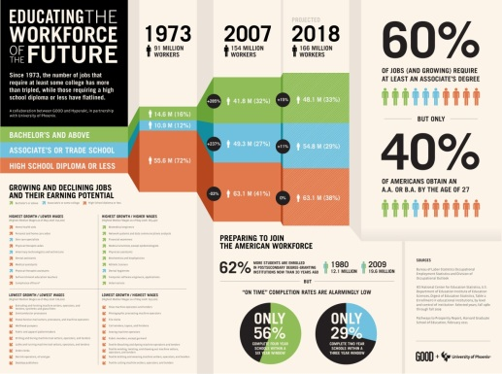
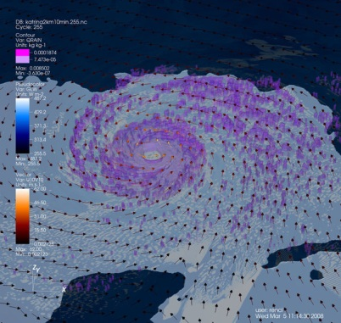
Data Visualization
A visualization is a picture created to explore, analyze, or explain something (observed phenomenon or quantitative data)

Slide 4
Some Examples of Visualizations
Commonly available data visualizations include poster-like, aesthetic ‘single serve’ displays we call info graphics.
Two examples of “info graphics” from www.Visualizing.org
Notes:
One type of data visualization is info graphics – information displays created primarily by graphics designers to represent complicated data and concepts. Typically info graphics are ‘single serving’ and often meant to be aesthetic and catchy.

Slide 5
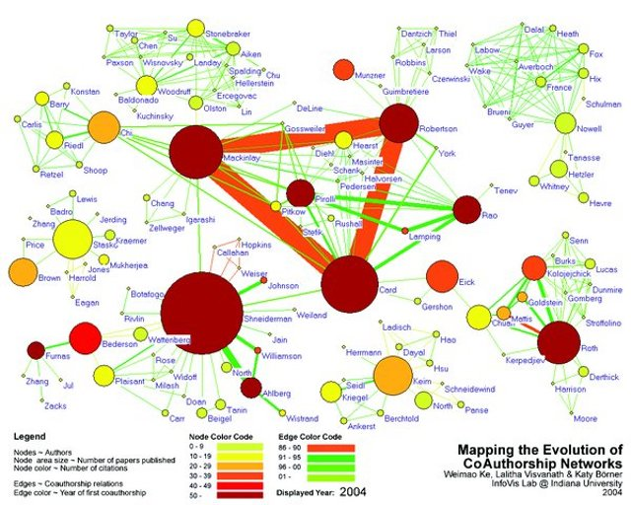
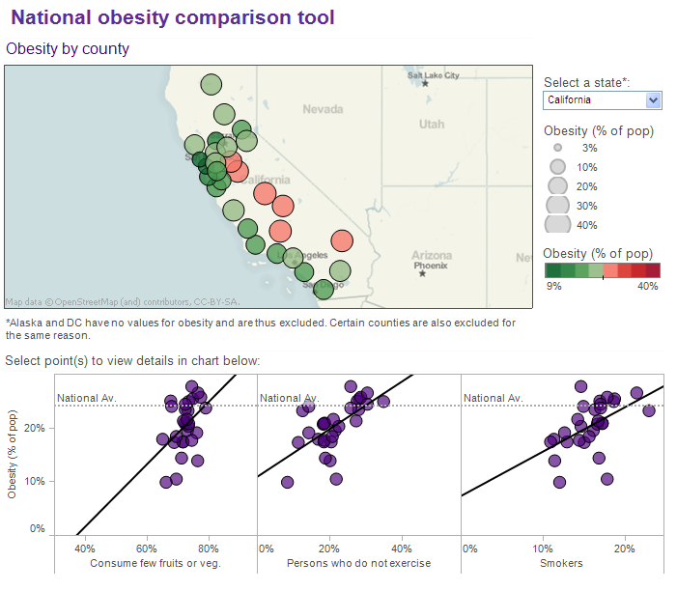
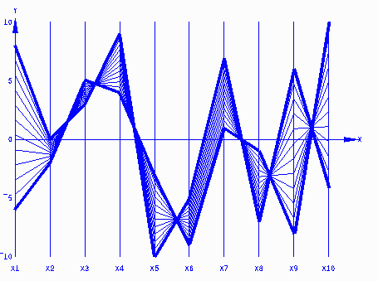
Some Examples of Visualizations
Multiple parameters
Relationships
High-dimensional data
Observed/simulated
scientific data
Hierarchical Relationships
Notes:
Of course there are a number of standard visualization methods. Many of techniques have been developed to explore data with multiple parameters or variables. Other techniques have been developed to specifically explore dense data or

Slide 6
Advantages of Data Visualization
Graphical representations and data visualizations have tremendous potential to
succinctly convey complicated concepts
enable analysis of multiple parameters and their relationships
enable fast perception of important information in a large data set
generate insight and knowledge
Interactivity provides additional means to explore dense data and discover novel relationships

Slide 7
A Challenge to Effective Visualization
People who develop graphs and charts are often not familiar fundamental concepts of visualization and visual perception
Visualization experts and practitioners often lack knowledge about the domains they need to serve
How do we encourage creation of data visualizations that are effective and useful to others?
Notes:
Foremost among challenges to effective visualization is the lack of training and familiarity of a visualization practitioner and the domain that is to be served. One pre-requisite is that the visualization developer should pose and understand important analytical questions and data analysis workflow of a user or client.

Slide 8
A Task-Centric Approach to Effective Visualization
Determine the ultimate, overall motive of creating a picture…
Determine the specific analytical questions that the visualization is going to support
For example, key variables or attributes; relationships; or time-dependent behavior
Exploration,
Detailed Analysis
Confirm/Validate Hypotheses or Pose New Questions
Combine two or more of these
Share or Present Results of Analysis

Slide 9
Task-Centric Approach…
Understand the data workflow
how data is processed and eventually analyzed
what are the key variables that need to be highlighted
Perform a simple task analysis
What is the end user’s primary goal in using a visualization. For example, a primary goal can be fast comparison of quantitative data (stock market, weather graph) or deep analysis of data
What is the secondary goal - for example, a secondary goal can be perception of patterns and trends over time
Develop graphical representations to support the task hierarchy
Notes:
Understanding the nature of data and information that needs to be analyzed can often dictate what types of visualization would be effective. Another dimension in a task-centric approach is to determine the ultimate motive of creating pictures. Often, the goals are combination of one or more of the tasks shown in the graphic.

Slide 10
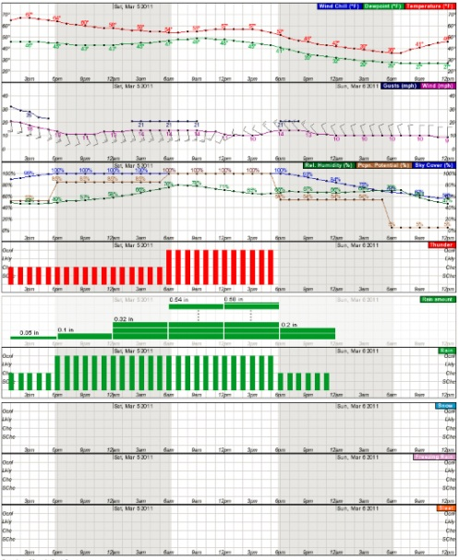
Real-World Application
Design of some weather-related products to support decision to close schools during adverse winter weather.
Visualization Challenges:
Users have little training to use graphical data displays
Information overload
Little time to dwell over complicated graphs/charts

Slide 11
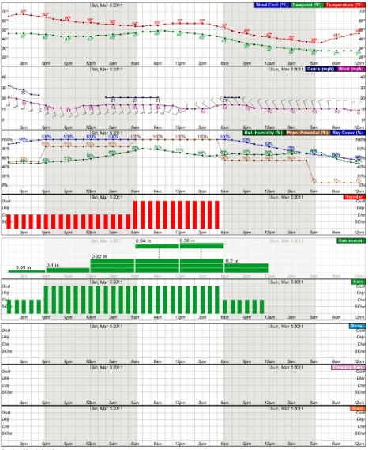
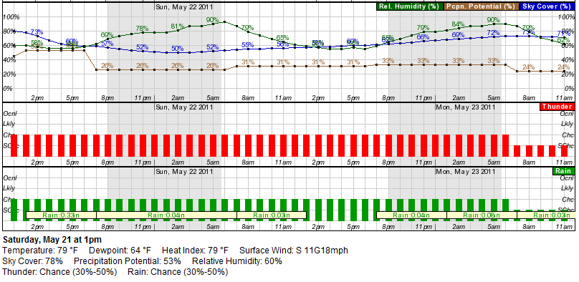
Example 1: Hourly Weather Graph Redesign
User task: identify rainfall amount and likelihood
Notes:
A screen shot of a section of a standard Hourly Weather Graph served to a number of different types of customers. Notice the use of bars to represent probabilities and text to display amount of rainfall. For the purpose of comparing quantitative data, textual-representation is the slowest. Also people generally have a hard time interpreting probabilities.

Slide 12
Notes:
A simple redesign of the information in the panel to display rainfall amount. Stacked bars with text for amount of rainfall are used to simplify a user’s task of quickly accessing forecasted conditions.

Slide 13
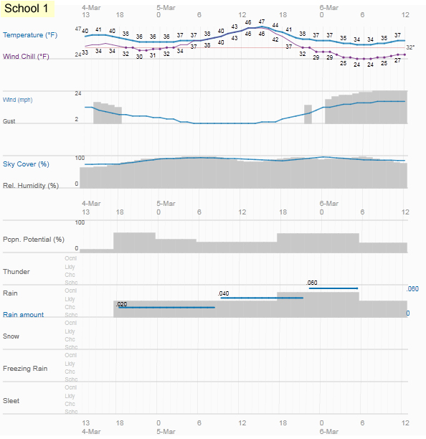
Broader Redesign of the Graph
There are some other issues related to how data is displayed in this chart.
Notes:
An over haul of the entire graph based on a simplified ‘minimalist’ design to direct user’s attention to only the most important data. Notice that color is used sparingly and many ‘chart junk’ elements such as grids and unnecessary text have been removed. Some of these elements can be provided optionally in interactive charts.

Slide 14
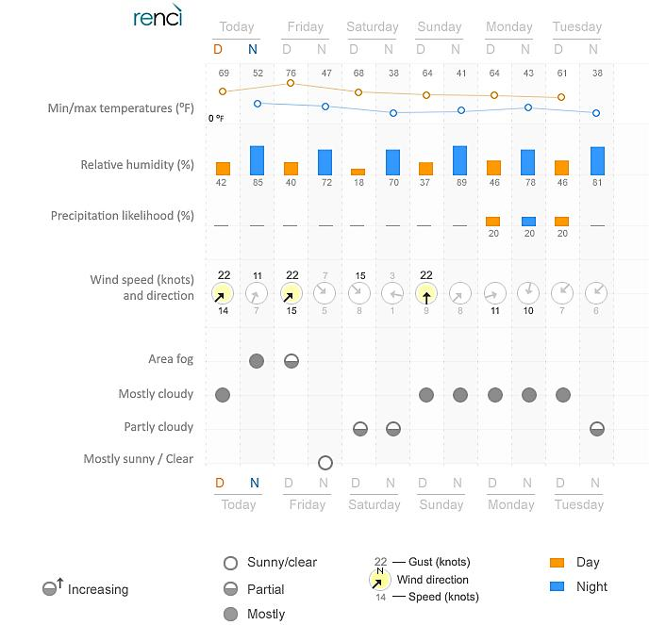
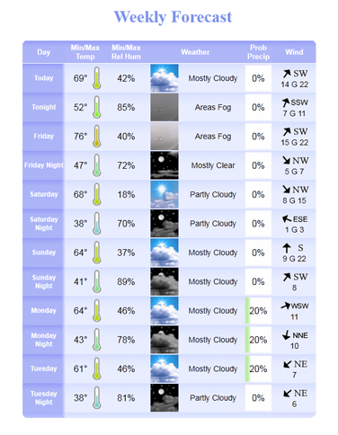
Example 2: Graphical Forecast
A graphical forecast is meant to be a visual summary.
In this example, however, users have to work hard to extract information because they have to process each piece of information serially.
Modified Chart
Standard Chart
Notes:
Another example of re-design by carefully considering information users may seek.

Slide 15
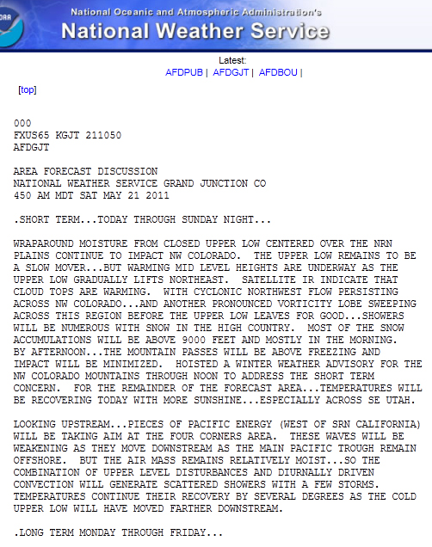
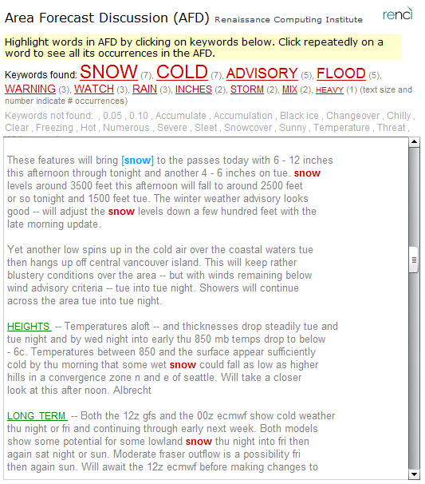
Example 3: Area Forecast Discussion
Tag cloud visualization
As the final example, I have chosen a text-based product to show that simple visualization methods can enhance text display too.
Primary task of users is to extract salient information about weather. We identified in user interviews that they look at specific keywords and phrases.
The redesign makes the task easier.
Notes:
Redesign of an Area Forecast Discussion (AFD) to facilitate easy reading and identification of important terms that pertaining to weather-related events.

Slide 16
Summary: Some Pre-requisites to Effective Visualization
Understand the process of visual perception
Define the purpose of your visualization
exploration and deep analysis,
confirmation or validation,
sharing and presentation of results
Prioritize analytical tasks that your visualization/graphic is going to support
Understand properties of the data you need to visualize
Whenever possible, use interactivity to allow users to engage with the visualization
Explore and Perform Deep Analysis
Confirm or Validate Hypotheses
Share and Present results or concepts

Slide 17
Resources
Business Intelligence Blog – PerceptualEdge.com
Visualization Blog – EagerEyes.org
Collaborative/Shared Visualizations – ManyEyes.org
Visual-Analytical tool – Tableau.com
Collin Ware’s “Visual Thinking: for Design,” (Morgan Kaufmann Series in Interactive Technologies)
Info Graphics by New York Times
Thank You
Special Thanks to Ray Idaszak, Jim Mahaney, and Hong Yi of RENCI and Institute for Emerging Issues.

